Slide 1

Assignment3
201811280 이승제

Slide 2
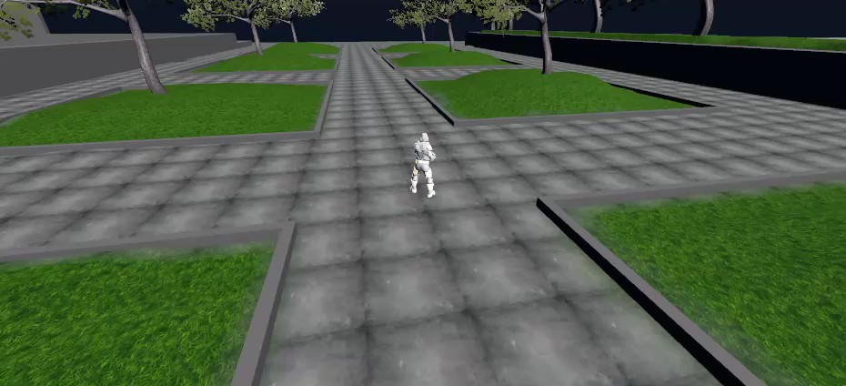
GamePlay
New Feature – “JUMP”

Slide 3

Thank you

